Slide 2
Outbreak Investigation and Treatment Challenges
Ratodero, District Larkana, Pakistan
Fatima Mir Assistant Professor Aga Khan University
@FatimaMirPedsID
Share your thoughts on this presentation with #IAS2019

Slide 3
Initial Investigation (May 8-25)
Team Members of FELTP (Field Epidemiological and Laboratory Testing Program) collected data
  211 positive individuals interviewed
  18 households interviewed
All household members without prior documentation of HIV status were offered HIV testing
Parent/care giver completed interview for children <15

Slide 4




Household Example 1
Both Expired
Both Negative
Both Negative
Positive
Positive
Negative
Positive
Negative
Negative
Source: FELTP household investigation

Slide 5






Household Example 2
Both Negative
Both Negative
Negative
Both Negative
Negative
Negative
Positive
Negative
Both Negative
Source: FELTP household investigation
Positive

Slide 6
Household Example 3
Mother Has history of Blood Transfusion before the birth of last two baby
Mother Positive, Father Expired
Mother Positive, Father Negative
Negative
Negative
Both Negative
Negative
Negative
Positive
Negative
Source: FELTP household investigation
Positive

Slide 7
Limitations of this Investigation
Public perceptions shaped by media trial of ‘the’ physician held responsible
Non-prequalified HIV and HCV tests stored at >30ºC
Prior closure of private clinics not allowing direct observation
High rates of injection use in both cases and controls
No HIV testing data in ANC, TB, or other clinic settings

Slide 8
WHO Mission 1: Hypotheses
Vertical
  No testing in ANC Clinics
  Small number of positive mothers
Spill-over in general population
  HRGs→adult general population → vertical transmission
  HRGs →blood donation →blood transfusion
  HRGs → Iatrogenic → contaminated needles
Iatrogenic
  Most Likely driver of outbreak
Notes:
No routine testing at ANC
109 women registered at the PPTCT service in Larkana (2011 to date)
19 PW HIV+ identified during outbreak (denominator unknown)
Propagation from high-risk populations not straightforward
Sexual transmission from commercial sex work (Transgender, FSW, MSM) to adult general population, followed by vertical transmission
Iatrogenic transmission through the health-care system (Thalassemia patients)
Blood transfusions (IDU)
Propagation from these populations is unlikely to explain such a large number of pediatric cases without a concurrent high prevalence in the adult population

Slide 9
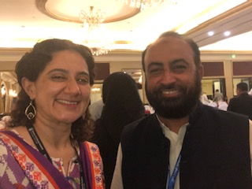

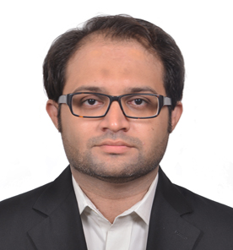
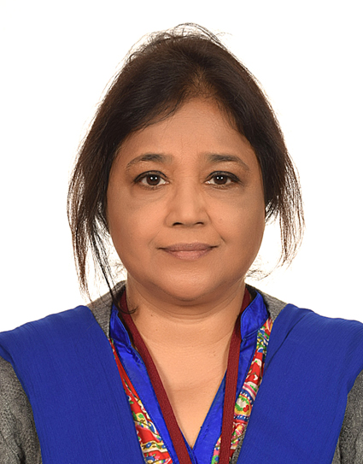

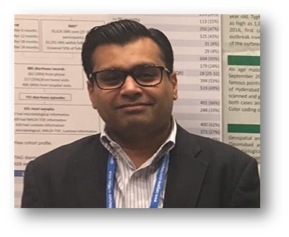

AKU Case Control Study
Objective:
  To identify mode of transmission in current outbreak (structured interviews)
  To do phylogenetic analysis of current cases and contextualize
  To do geo-profiling of cases
Method
  Matched case-control study in Ratodero, Larkana (age, sex, area of residence)
Investigators
  Fatima Mir (Pediatrics)
  Faisal Mahmood (Internal Medicine)
  Rehana Siddiqui (Community Health Sciences)
  Syed Hani Abidi (Basic and Biological Sciences)
  Momin Kazi (Pediatrics)
  Rashida Ferrand (Epidemiology/Public Health)
  Sikander Memon, Saqib Shaikh (SACP)

Slide 10
Methods
Sample Size:
  406 HIV cases and 406 controls, matched on age, sex and area of residence
  80 percent power if the probability of exposure (injection use) among sampled controls is ranging between 0.10 to 0.85
  correlation coefficient for exposure between matched HIV case and control subjects is 0.20
  anticipated odds ratio of at least 2
  two sided level of significance of 0.05
Progress
Timeline | # Cases GIS Completed | # Cases bloods collected | # Cases Interviews Completed | # Cases mothers retested | # Control bloods collected | # Control Interviews Completed | # Controls mothers retested
May 13 to date | 264 37 HCPs | 228 (10) | 45 | 45 | 0 | 0 | 0

Slide 11
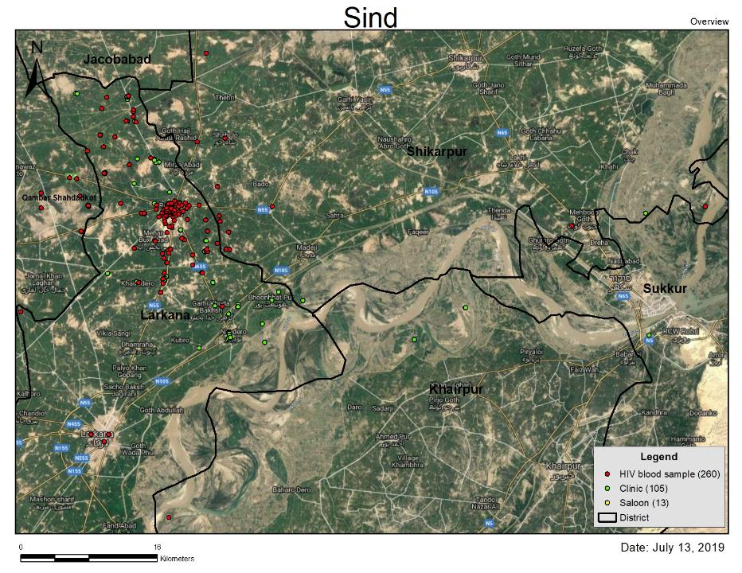


Slide 12
Way Forward: Epidemiology
Activity (Epidemiology) | Qtr2, 2019 | xxQtr3, 2019 | Qtr4, 2019 | Qtr1, 2020 | Qtr2, 2020 | Qtr3, 2020
Screening Camp (Strategy, Kits, Continuation, Data Entry) | x | x | x | x | x | x
Procurement of WHO-prequalified RDT kits | X | X
Development of Electronic Data Dashboard | x | X
Integration of screening camp setup into Ratodero HIV Center at THQ Hosp |  |  |  | x
FELTP Investigation (WHO Mission 1) | x | x | x
AKU Investigation ERC GIS Mapping Blood Samples for Phylogenetics/HCV/HBSag Interviews | x | x | x

Slide 13
Treatment and Care Services on the ground-March 2019
Provinces | ART Centers | Adults Ever Registered | Adults Actively Registered | PPTCT Centers | Paeds Treatment Centers | Children Ever Registered | Children Actively Registered
Federal | 2 | 3080 | 2305 | 1 | 1 | 66 | 50
Khyber Pakhtunkhwa | 3 | 3006 | 1906 | 1 | 1 | 143 | 98
Gilgit-Baltistan | 0 | 0 |  | 0 | 0
Punjab | 19 | 17366 | 11595 | 3 | 3 | 752 | 600
Baluchistan | 2 | 1114 | 806 | 1 | 1 | 37 | 28
Sindh Larkana | 9 1 | 9972 2370 | 7579 1607 | 1 1 | 1 0 | 425 20 | 265 19
Total | 35 | 34,538 | 24,191 | 8 | 7 | 1423 | 1041
Communication: National AIDS Control Program/UNAIDS

Slide 14
Care and Treatment in Larkana
One Adults HIV clinic (25 km from Ratodero)
No Children HIV clinic (Center in Karachi: 450 km from Ratodero)
Establishment of 1 Paediatric HIV Clinic
  2 physicians trained on the job by AKU
  Clinic understaffed and very crowded, confidentiality is a serious issue
  Mother status is based on self-reported status.
  NAT for confirming diagnosis of children<18 m not done
POC CD4 testing available but provides absolute number
Hepatitis B and C testing using low quality test kits

Slide 15
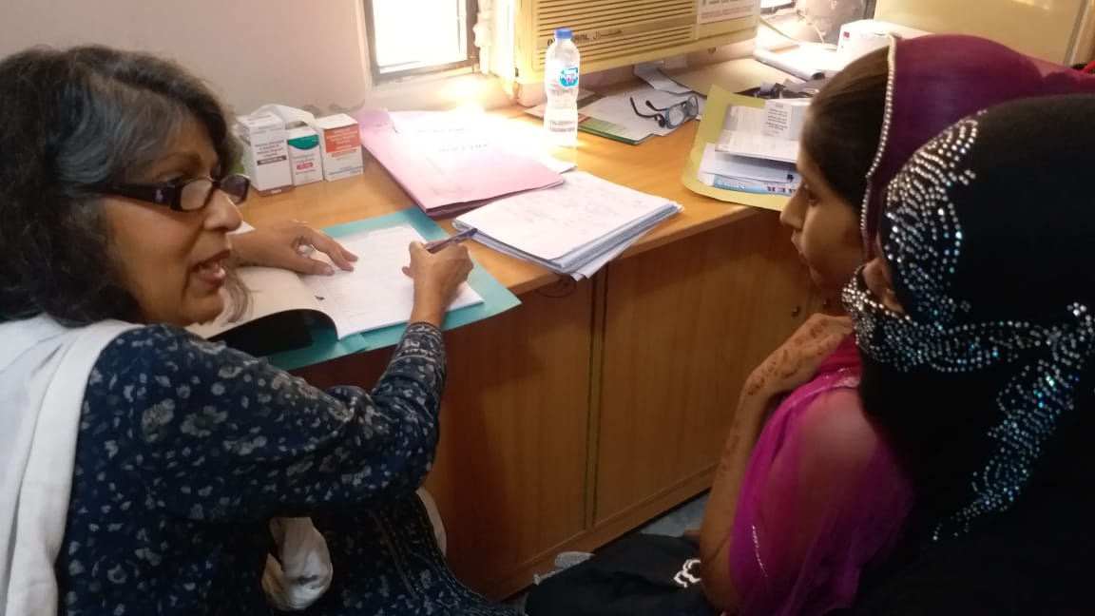
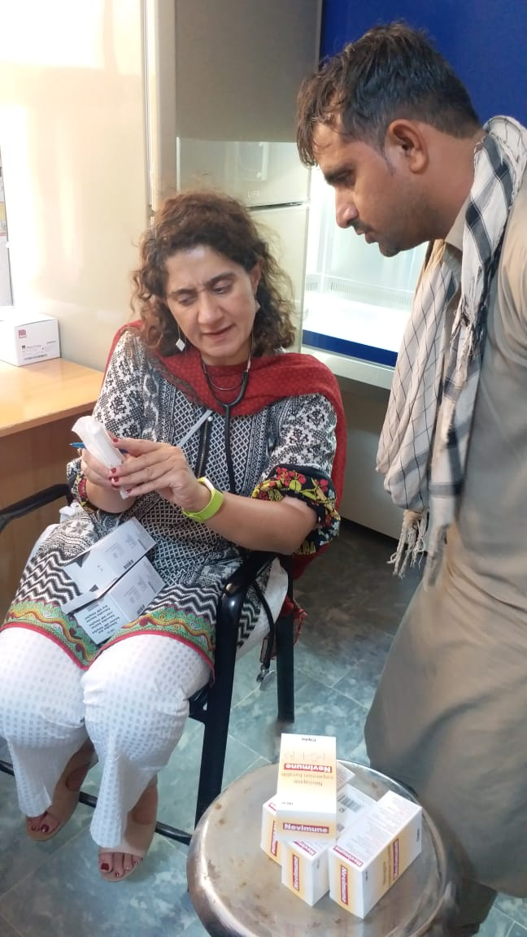
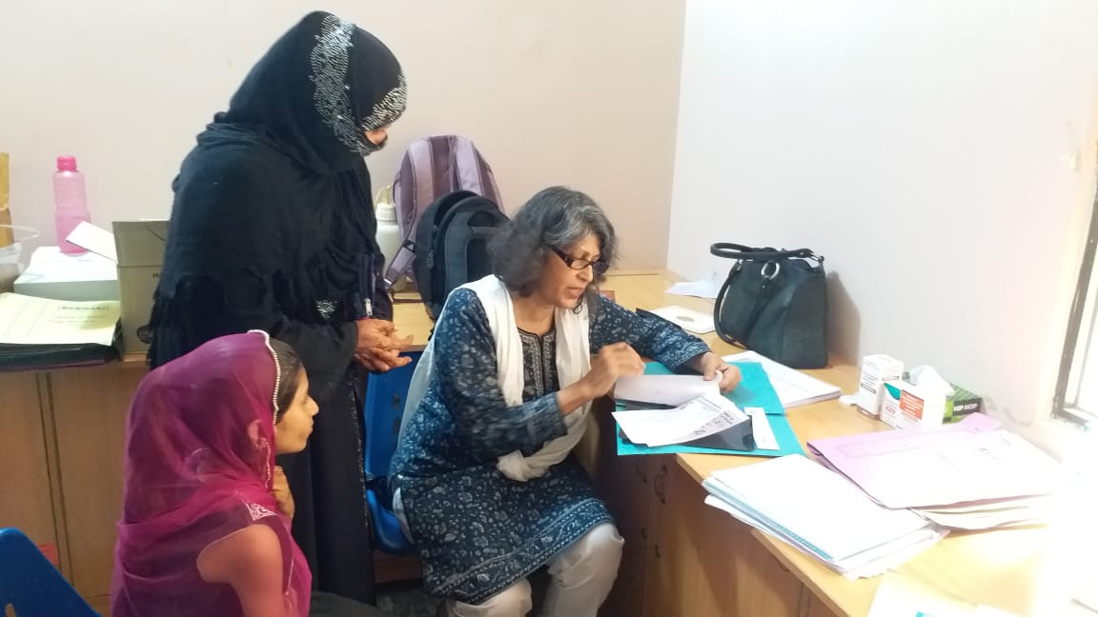
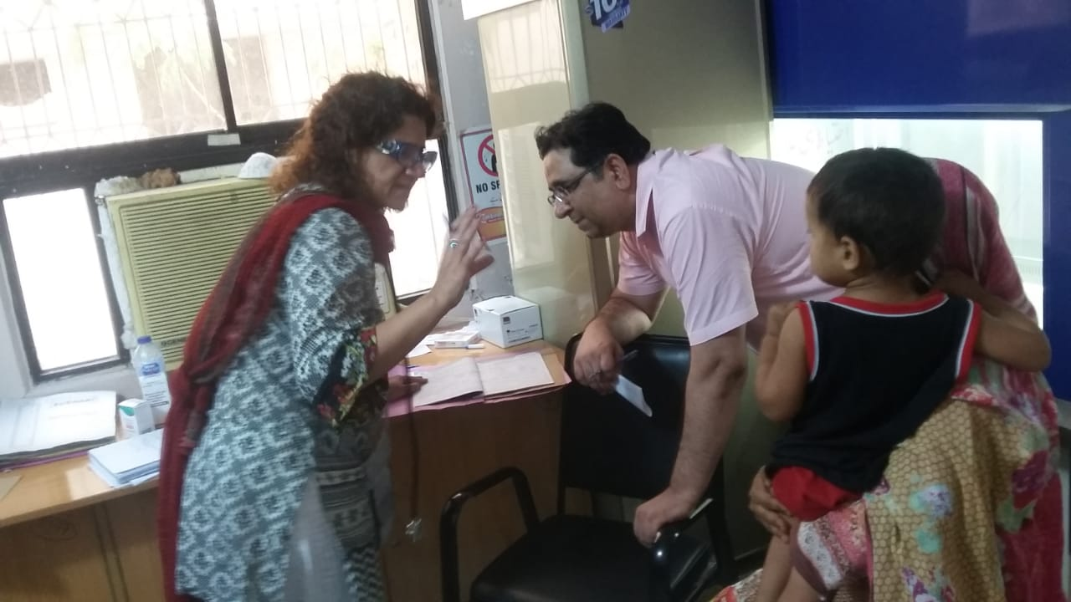
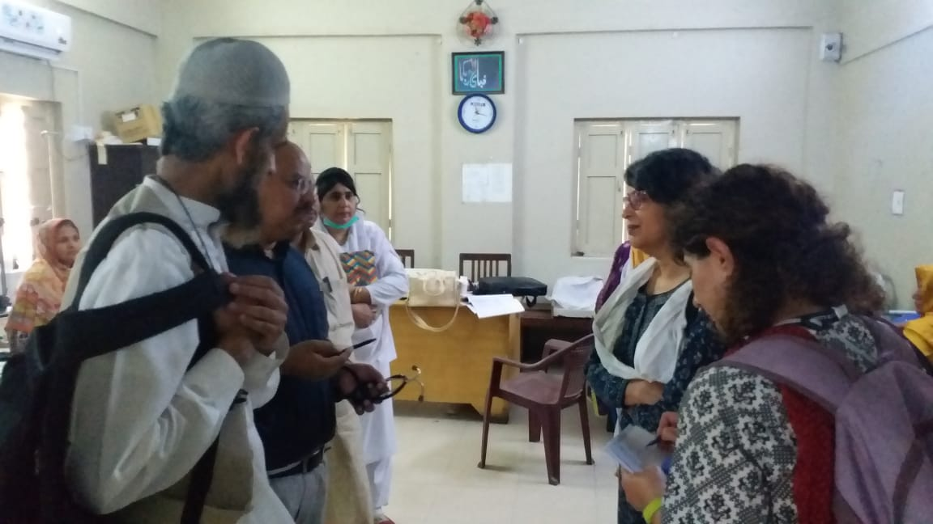
Starting from scratch

Slide 16
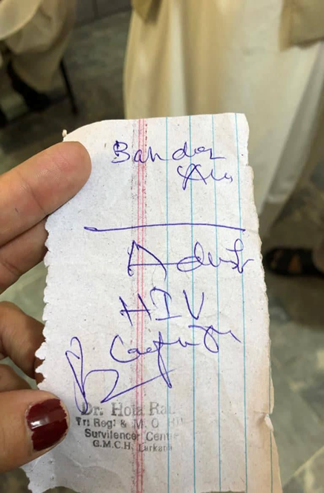
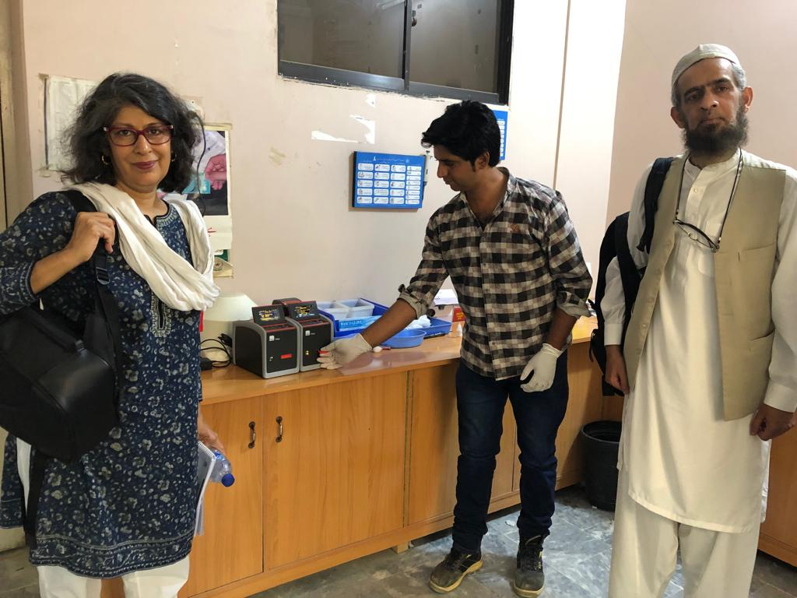
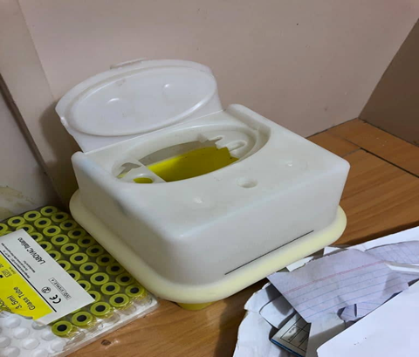
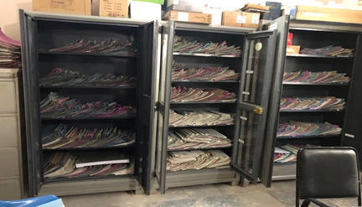
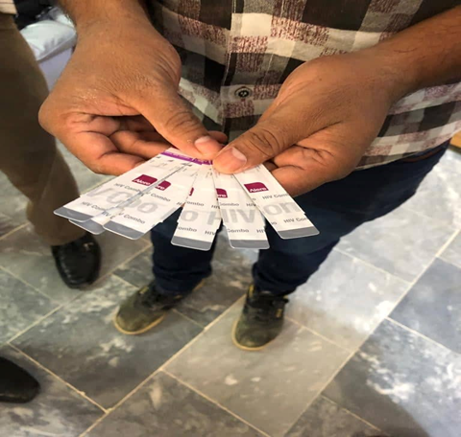
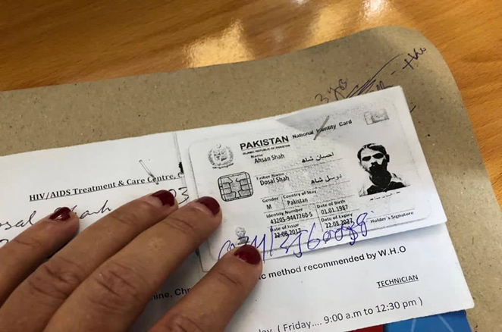
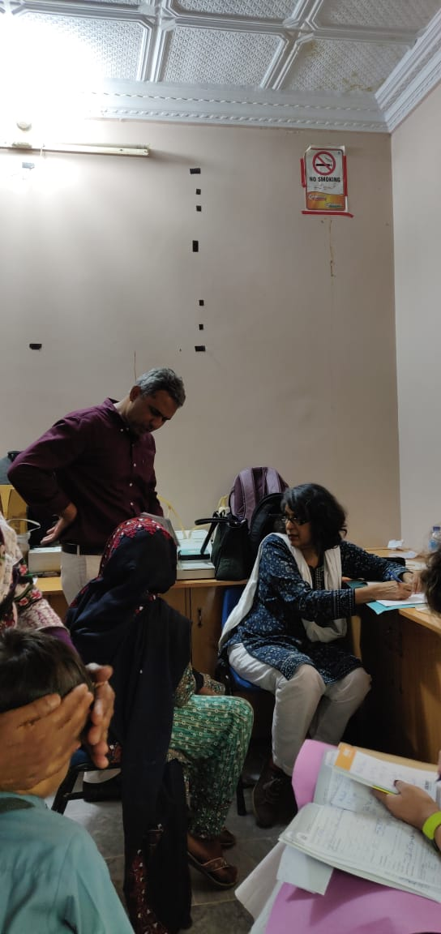
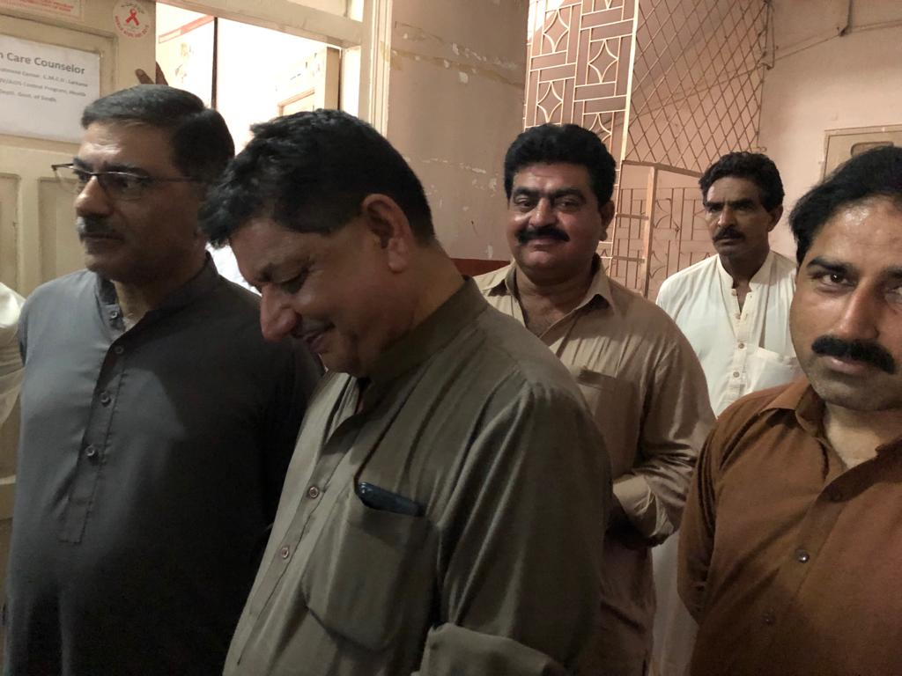
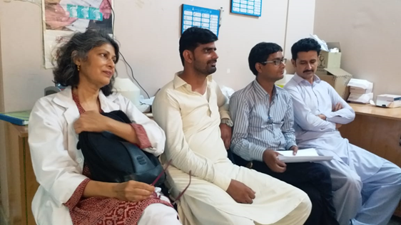
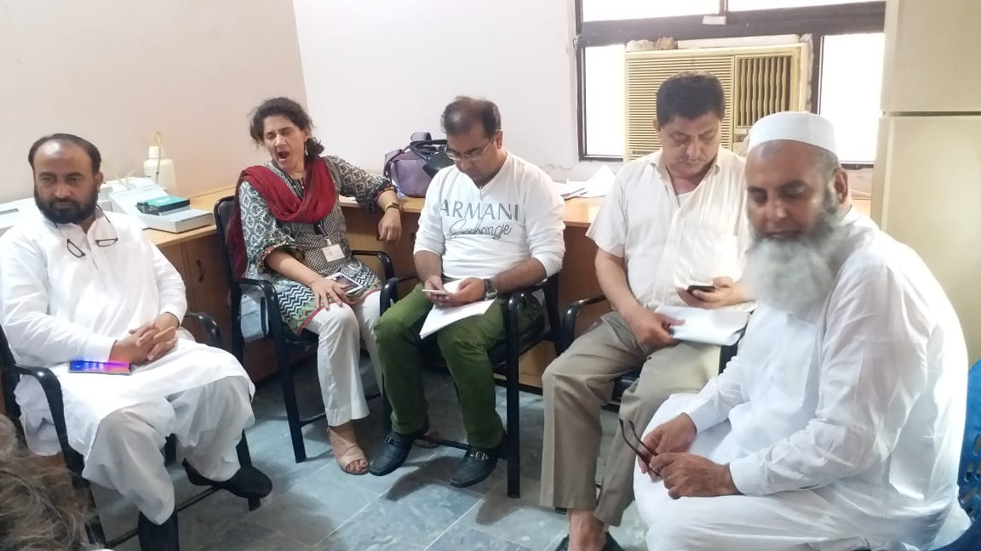
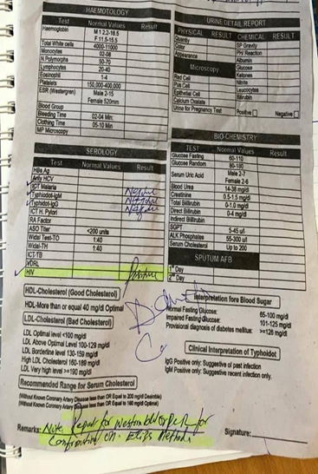
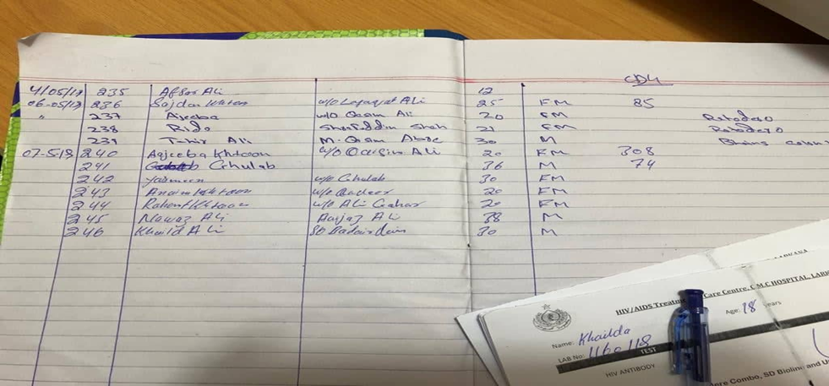
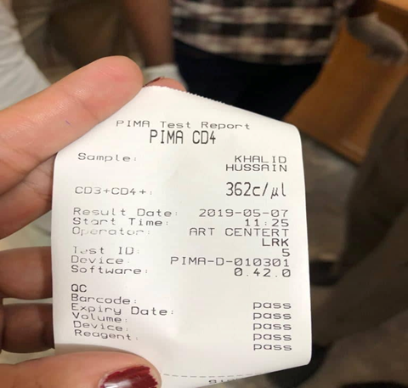
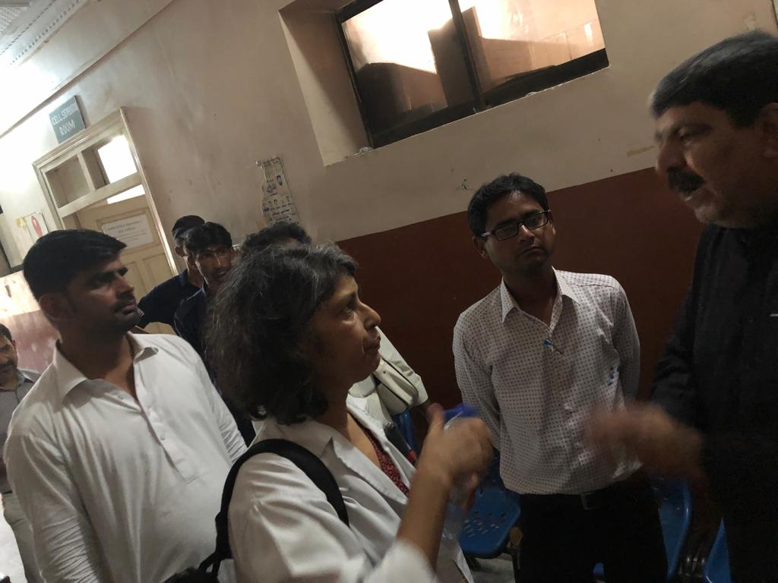
Makeshift Pediatric Clinic

Slide 17
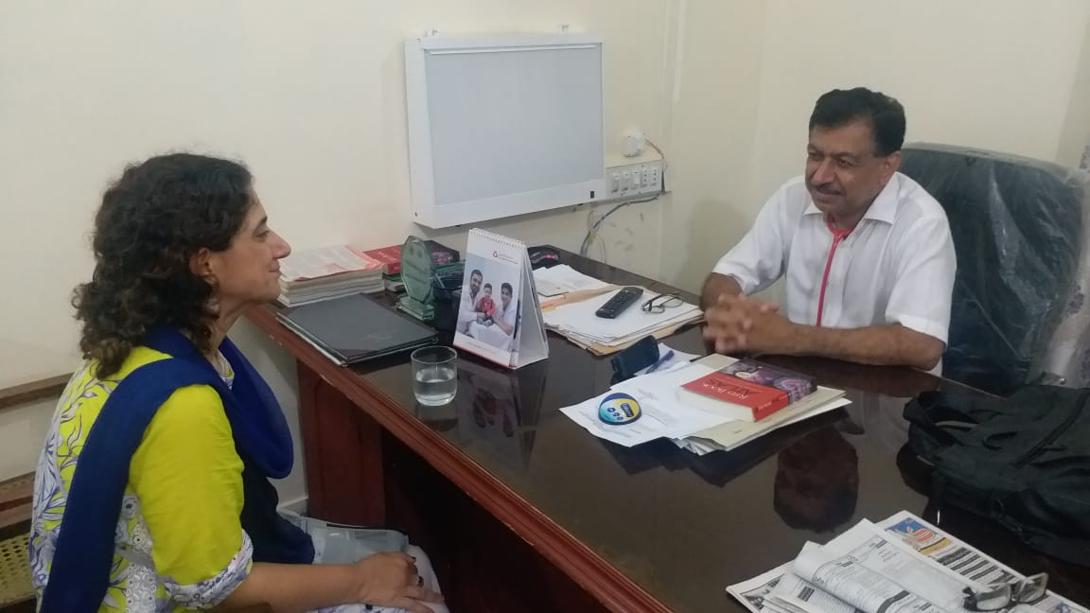
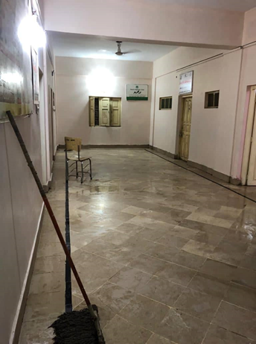
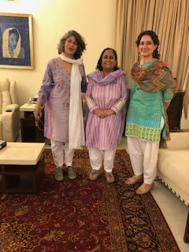
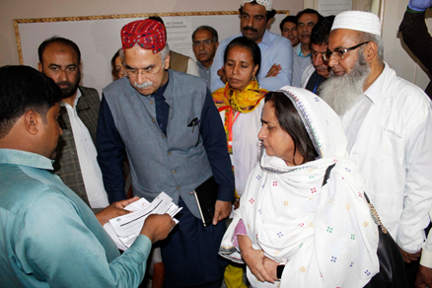
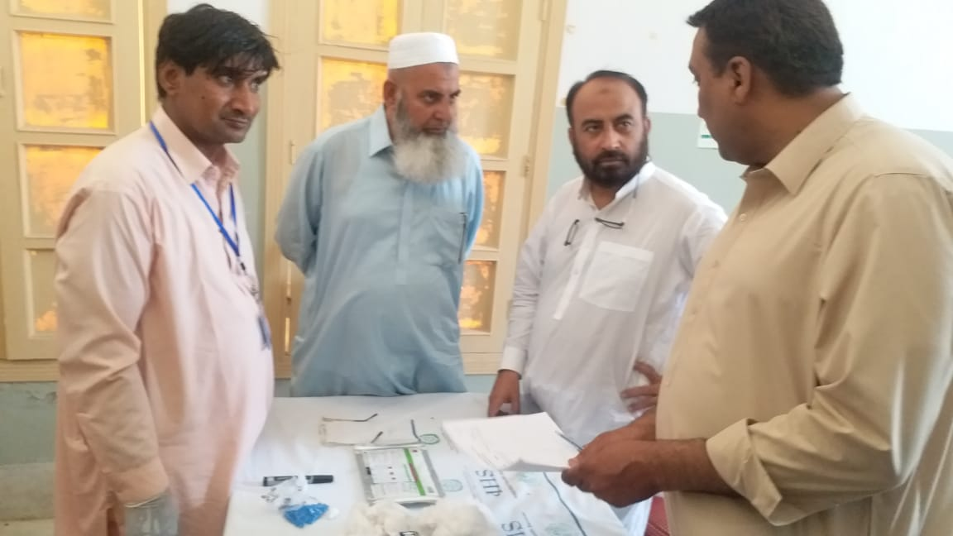
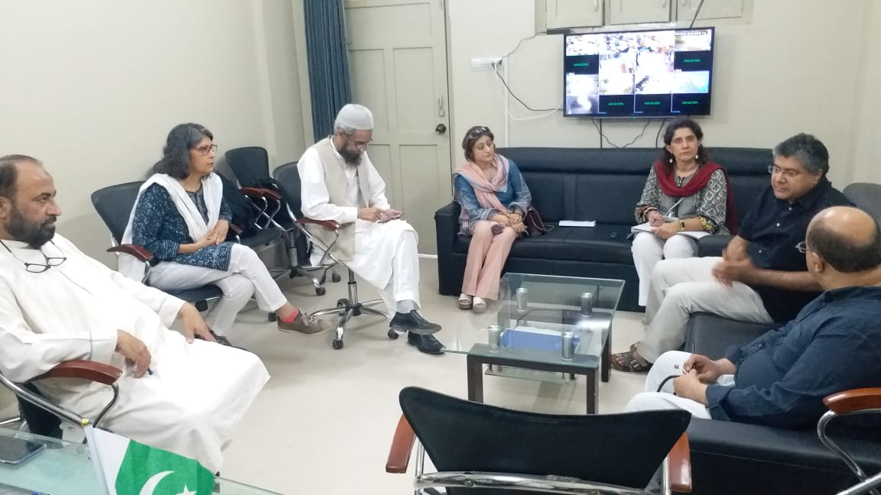
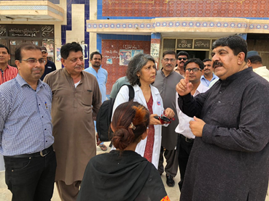
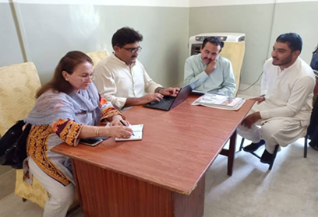
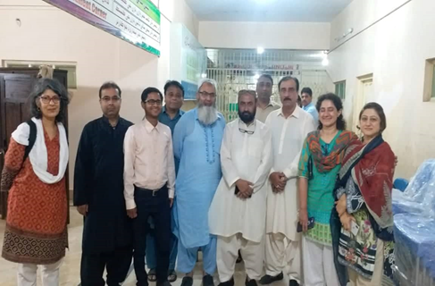

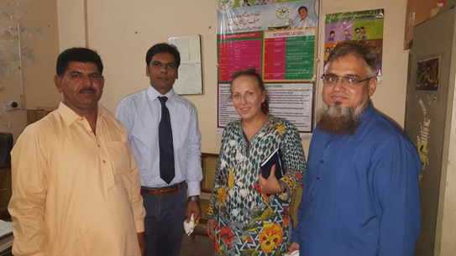
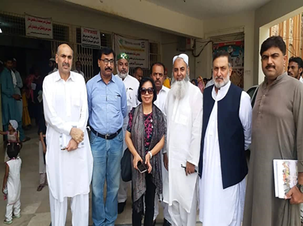
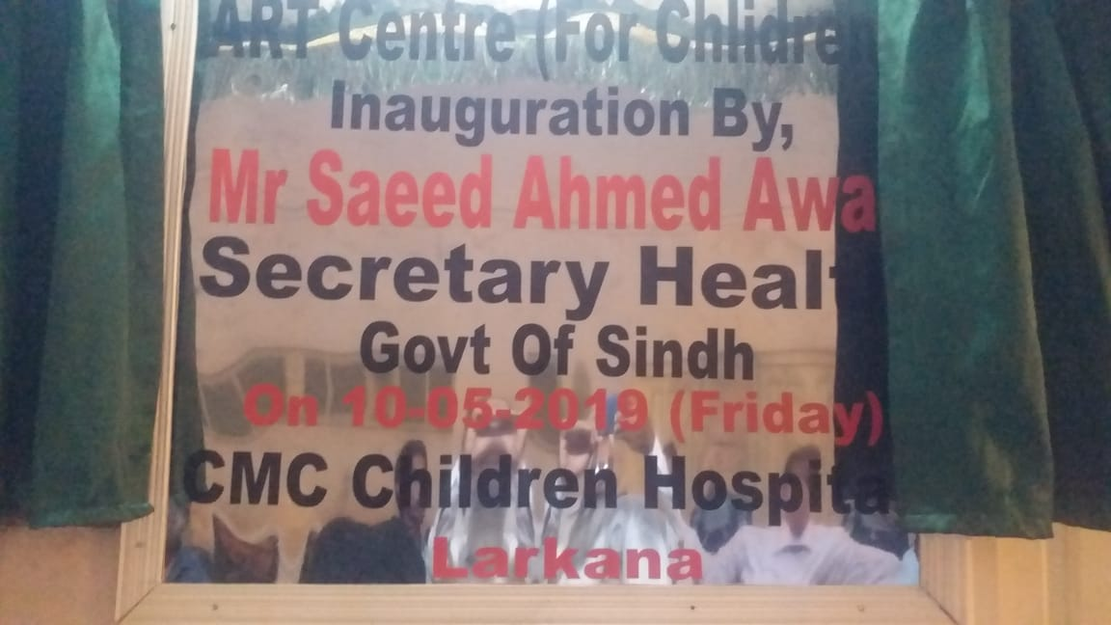
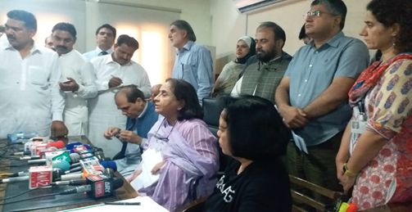
Space

Slide 18
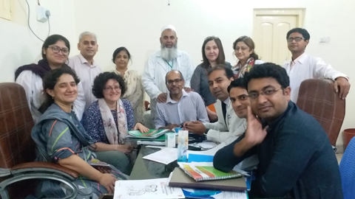
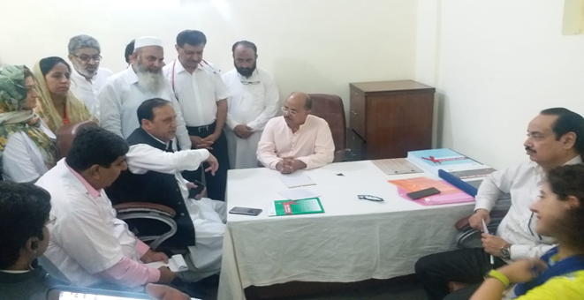
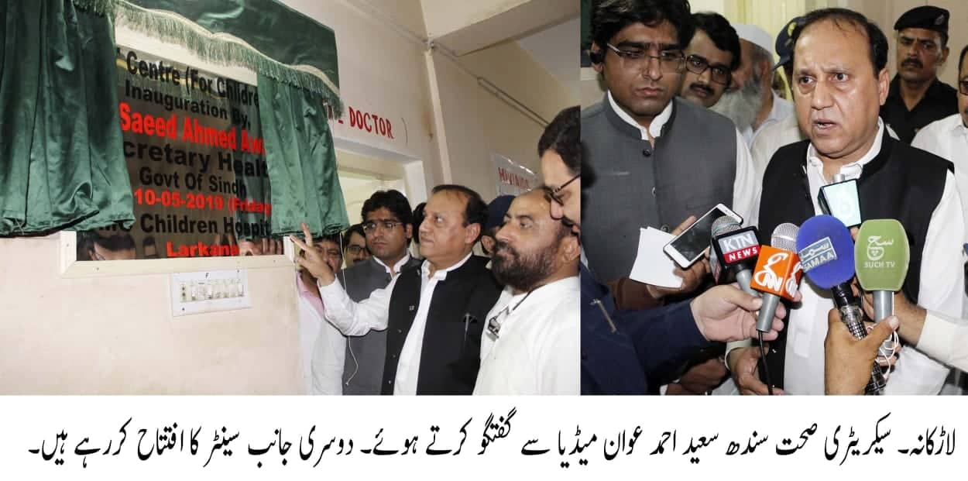
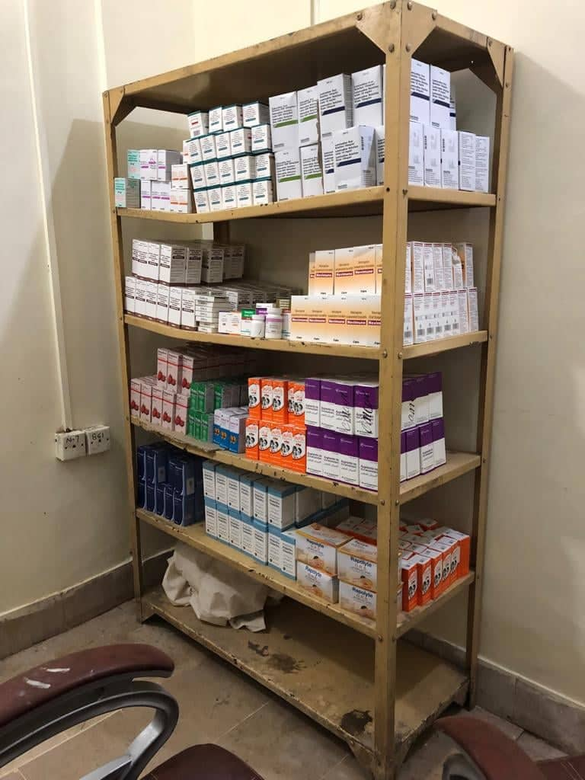
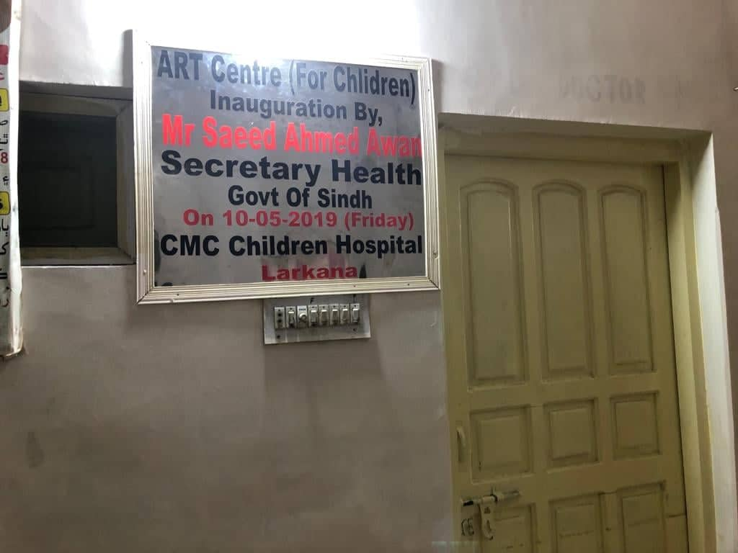
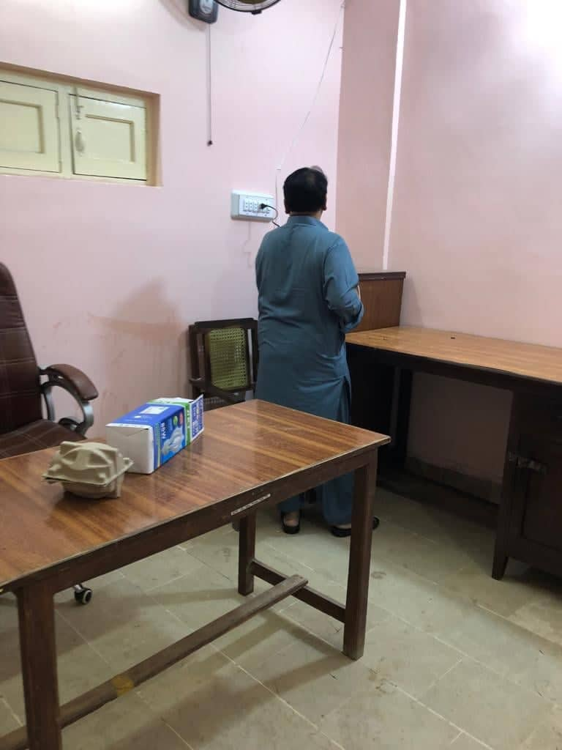
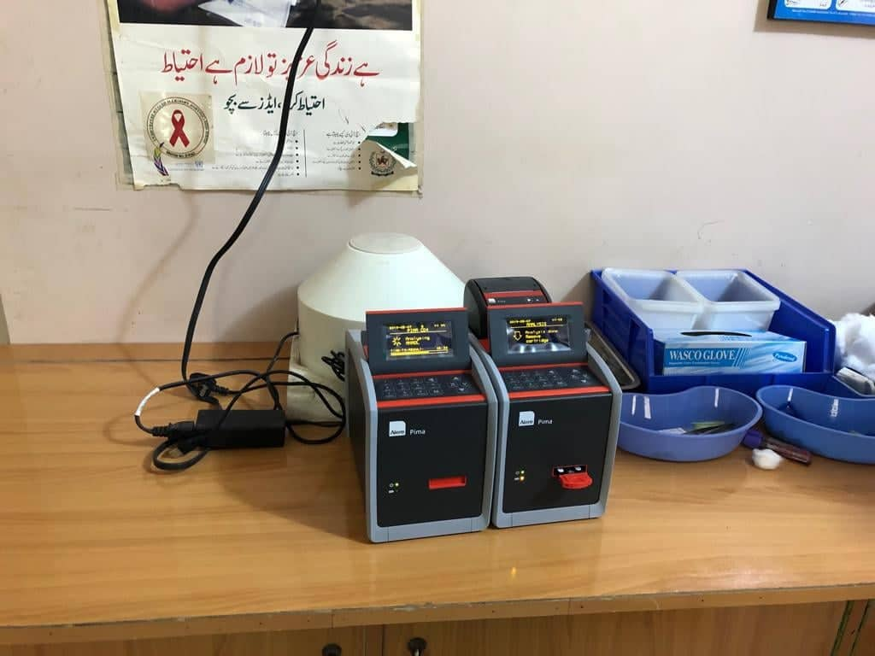
Pediatric HIV Center at Shaikh Zayed Childrens Hospital
Weight, MUAC
Nutritional Assessment
Clinical Staging
Laboratory tests at baseline
TB Score
Coinfections
Treatment Criteria
Treatment Regimen
Follow up Information

Slide 19
Pediatric Care: adjusted ART regimens
No reports of high level of NNRTI resistance in the country
No prior exposure to maternal or prophylactic ARV in identified children
LPVr syrup has been introduced in Karachi with low level of acceptability:
    Low skills among HCWs and caregivers
      user-friendly formulations are crucial to ensure adherence
    Temperature in Larkana reaches over 50 ºC in summer
    Global capacity low to ensure constant in-country availability of LPVr pellets or granules
Population | Regimens | Formulations
<3 y | AZT / 3TC / NVP | FDC dispersible tablet
≥ 3 y & < 20 kg | ABC / 3TC / EFV | ABC/3TC dispersible EFV 200 mg
≥ 20 to < 30 kg | ABC /3TC / DTG | ABC/3TC dispersible DTG 50 mg tablet
≥ 30 kg | TDF/ 3TC / DTG | TLD FDC
If TLD is not available TLE can be used from 35 kg

Slide 20
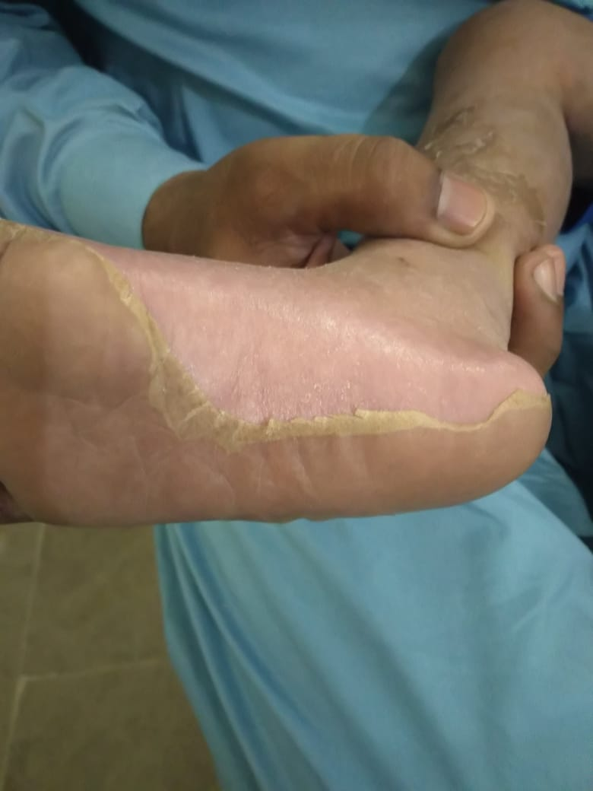
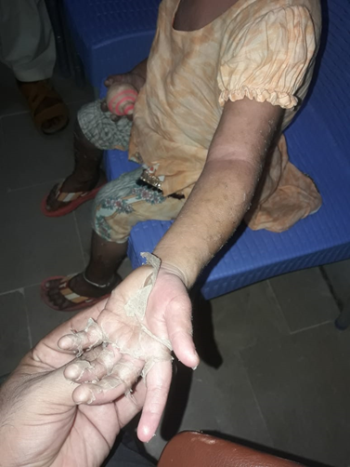
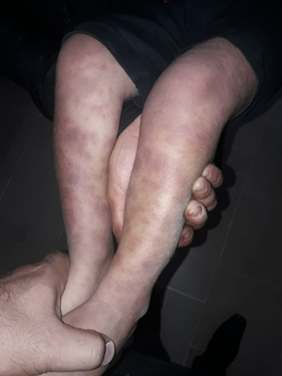
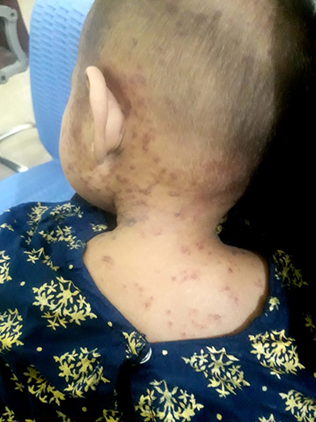
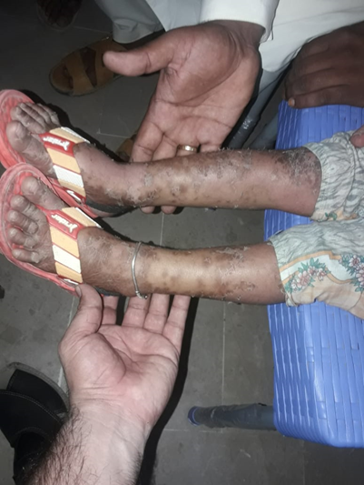
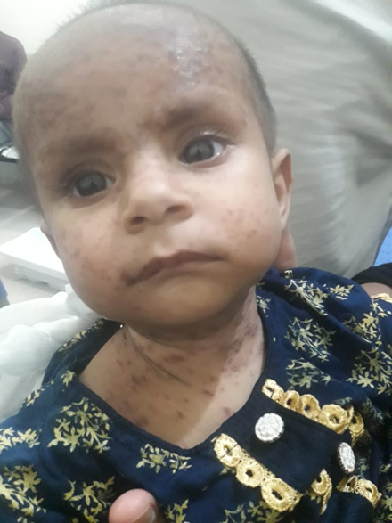

Nevirapine versus Cotrimoxazole

Slide 21
Potential attrition at each step in Patient Pathway
Diagnosed at testing camps
Laboratory for confirmatory test (3rd RDT)
If positive, laboratory for HBV, HCV, Hb and CD4
First consultation/ Patient file is open
Wait for ART initiation
Arrival at the Ped Clinic
Drop out?
Drop out?
Drop out?
Drop out?
Drop out?

Slide 22


Continuity and Sustainability in future strategy
WHO Mission 2: Training
WHO Mission 2: debriefing

Slide 23

HIV testing: revised algorithm & procurement
June 10 2019 - 50,220 tests arrived
Allere Determine: 37,000 Tests
Allere Combo: 9,500 Tests
Uni Gold: 3,720 Tests
Next planned procurement 60,000 RDT
Alere determine
Unigold
HIV 1/2 - Determine HIV Combo Kit – 100 tests | 500 Pack of 100 | 47,500 USD
HIV 1+2 - Uni-gold HIV Kit -20 tests | 80.0 Pack | 2,560 USD
HIV 1/2 - Bioline 3.0 Kit - 25 tests | 64.0 Pack | 1,312 USD
SD Bioline

Slide 24
Procurement of Pediatric ARV
Expedited procurement by the Global Fund: drugs expected in country in July 2019
Ethiopia identified and donation of 2000 vials of ZLN in process
Possible donation ARVs from USAID to WHO

Slide 25
Global Fund procurement ARVs
Requisition # | Supplier Order # | Product Description | Quantity | Docs Sharing date (ready to ship - waivers awaited) | Estimated Docs Sharing date for waivers | Estimated delivery date based on expedited waivers (1 week + 1 week shipping) | Expected Delivery Date assuming waivers take normal time | Status
First RSM Order
PE-51397 | PO-541820 | Nevirapine 10mg/ml, oral suspension w/syringe, Bottle,100 ml | 1,176 | 13-Jun-2019 |  | 28-Jun-2019 | 03-Jul-2019 | Ready to ship, pending waivers
PE-51397 | PO-541780 | Abacavir 300mg, tablets, 60 Tabs | 1,200 | 17-Jun-2019 |  | 02-Jul-2019 | 03-Jul-2019 | Ready to ship, pending waivers
PE-51397 | PO-541810 | Lopinavir/Ritonavir 80/20mg/ml [Kaletra], oral solution w/syringe, cool, Bottle 5 x 60 ml | 144 |  | 21-Jun-2019 | 06-Jul-2019 | 11-Aug-2019 | Documents will be shared this week
PE-51397 | PO-541800 | Zidovudine 10mg/ml, oral solution w/syringe, Bottle, 240 ml | 600 |  | 18-Jun-2019 | 03-Jul-2019 | 08-Aug-2019 | Documents will be shared this week
PE-51397 | PO-541801 | Zidovudine 10mg/ml, oral solution w/syringe, Bottle, 240 ml | 600 |  | 01-Jul-2019 | 16-Jul-2019 | 21-Aug-2019 | 50% from stock remaining 50% from fresh production
PE-51397 | PO-541790 | Lamivudine 10mg/ml, oral solution w/syringe, Bottle, 240 ml | 870 | 13-Jun-2019 |  | 28-Jun-2019 | 03-Jul-2019 | Ready to ship, pending waivers
PE-51397 | PO-541830 | Lamivudine/Nevirapine/Zidovudine 30/50/60mg, dispersible tablets, 60 Tabs | 2,880 | 13-Jun-2019 |  | 28-Jun-2019 | 03-Jul-2019 | Ready to ship, pending waivers
Second RSM Order
PE-51439 | PO-542570 | Efavirenz 200mg, double-scored tablets, 90 Tabs | 2,884 |  | 20-Jun-2019 | 05-Jul-2019 | 08-Aug-2019 | Documents will be shared this week
PE-51439 | PO-542590 | Efavirenz 200mg, double-scored tablets, 90 Tabs | 298 |  | 28-Jun-2019 | 13-Jul-2019 | 18-Aug-2019 | Major part from stock, remaining (small part) from fresh production
PE-51439 | PO-542600 | Dolutegravir 50mg, film-coated tablets, 30 Tabs | 632 |  | 25-Jun-2019 | 10-Jul-2019 | 08-Aug-2019 | Documents will be shared this week
PE-51439 | PO-542580 | Abacavir/Lamivudine 120/60mg, dispersible tablets, 30 Tabs | 11,444 |  | 20-Jun-2019 | 05-Jul-2019 | 10-Aug-2019 | Documents will be shared this week
PE-51439 | PO-542570 | Lamivudine/Nevirapine/Zidovudine 30/50/60mg, dispersible tablets, 60 Tabs | 4,357 |  | 20-Jun-2019 | 05-Jul-2019 | 08-Aug-2019 | Documents will be shared this week

Slide 26
Treatment and Care Recommendations
Capacity Building
  New Clinic at Ratodero
  Recruit and train new staff (physicians, DEO, Counsellors, Case managers)
Training and Mentoring
  Develop comprehensive training module which incorporates growth assessment, nutritional management, TB Evaluation, vaccination, common childhood Illnesses, Opportunistic infections
  Simplified JobAids
  Relevant ICE Material for clients and caregivers
  Develop a cadre of Master Trainers and Remote Mentors
  Formalize linkages with important services
  Tele-links

Slide 27
Treatment and Care Recommendations
Developing a Provincial Strategy
  Patient monitoring laboratory capacity
    Consider shared use of GeneXpert machines, available in TB services, for viral load testing and EID
    Deploy POC technologies that can provide both absolute CD4 count and CD4% (for children < 5 years of age)
  Treatment
    ARV for all
Enabling health system
  Stigma reduction in health care settings using WHO/EMRO stigma reduction package
  Home health Plan (Involvement of “Ladies Health Workers”)

Slide 28
Way Forward: Treatment and Care
Activity (Treatment and Care) | Qtr2, 2019 | xxQtr3, 2019 | Qtr4, 2019 | Qtr1, 2020 | Qtr2, 2020 | Qtr3, 2020
Establishing New Pediatric Clinic In Larkana New recruitment, training, operationalization | x
Data Entry into MIS | X | X
Procurement of Rapid Kits | x | X
Procurement of ARV | x | x | x
Customization of Testing Guidelines Customization of Treatment and Care Guidelines Customization of Physician Training Modules Development of JobAids and ICE Material | X x | X X X x
Training of Master Trainers Training, Monitoring and Mentoring M&E |  | X X X | X X | X X | x X X | X X

Slide 29
The Team
Government of Sindh:
  Sindh Health Ministry, Sindh AIDS Control Program, Field Epidemiological and Laboratory Training Program
Federal Government:
  National AIDS Control program
Academia:
  The Aga Khan University
  London School of Hygiene and Tropical Medicine
  Dow University of Health Sciences
  The Indus Hospital
UN Agencies:
  WHO/UNICEF/UNAIDS/UNFPA

